Slide 1

Modernizing Legacy Code: A Case Study of React Implementation at CERN
Transitioning to a more efficient web application framework
D. Kekelidze, CERN
Pori Spring Campus, May 2025
Notes:
This presentation will explore the process of migrating a legacy JSP front-end to a modern single-page application using React. We'll discuss the benefits of React, core concepts, key considerations for migration, the migration path, practical implementation, and the final benefits of this transition.

Slide 2

Introducing Myself
Technical Team Lead and Product Owner within the Business Computing group at CERN.
Specialised in electronic document management and Role Based Access Control systems.
Committed to improve legacy systems at CERN.
Notes:
As a Technical Team Lead at CERN, I oversee the development and maintenance of essential libraries for our electronic document handling system. My role as a Product Owner involves ensuring that our RBAC system is robust and efficient. I am committed to enhancing system performance and collaboration within my team.

Slide 3

ASYNC Follow up

Slide 4
Agenda Items
Introduction to React and its Benefits
Core Concepts of React
Key Considerations for Migration
Migration Path to React
Code Examples and Practical Implementation
Final Benefits of Migration
Notes:
In this presentation, we'll cover the advantages of React compared to JSP, core React concepts, important factors to consider during migration, a step-by-step migration path, practical code examples, and the long-term benefits of migrating to React.

Slide 5
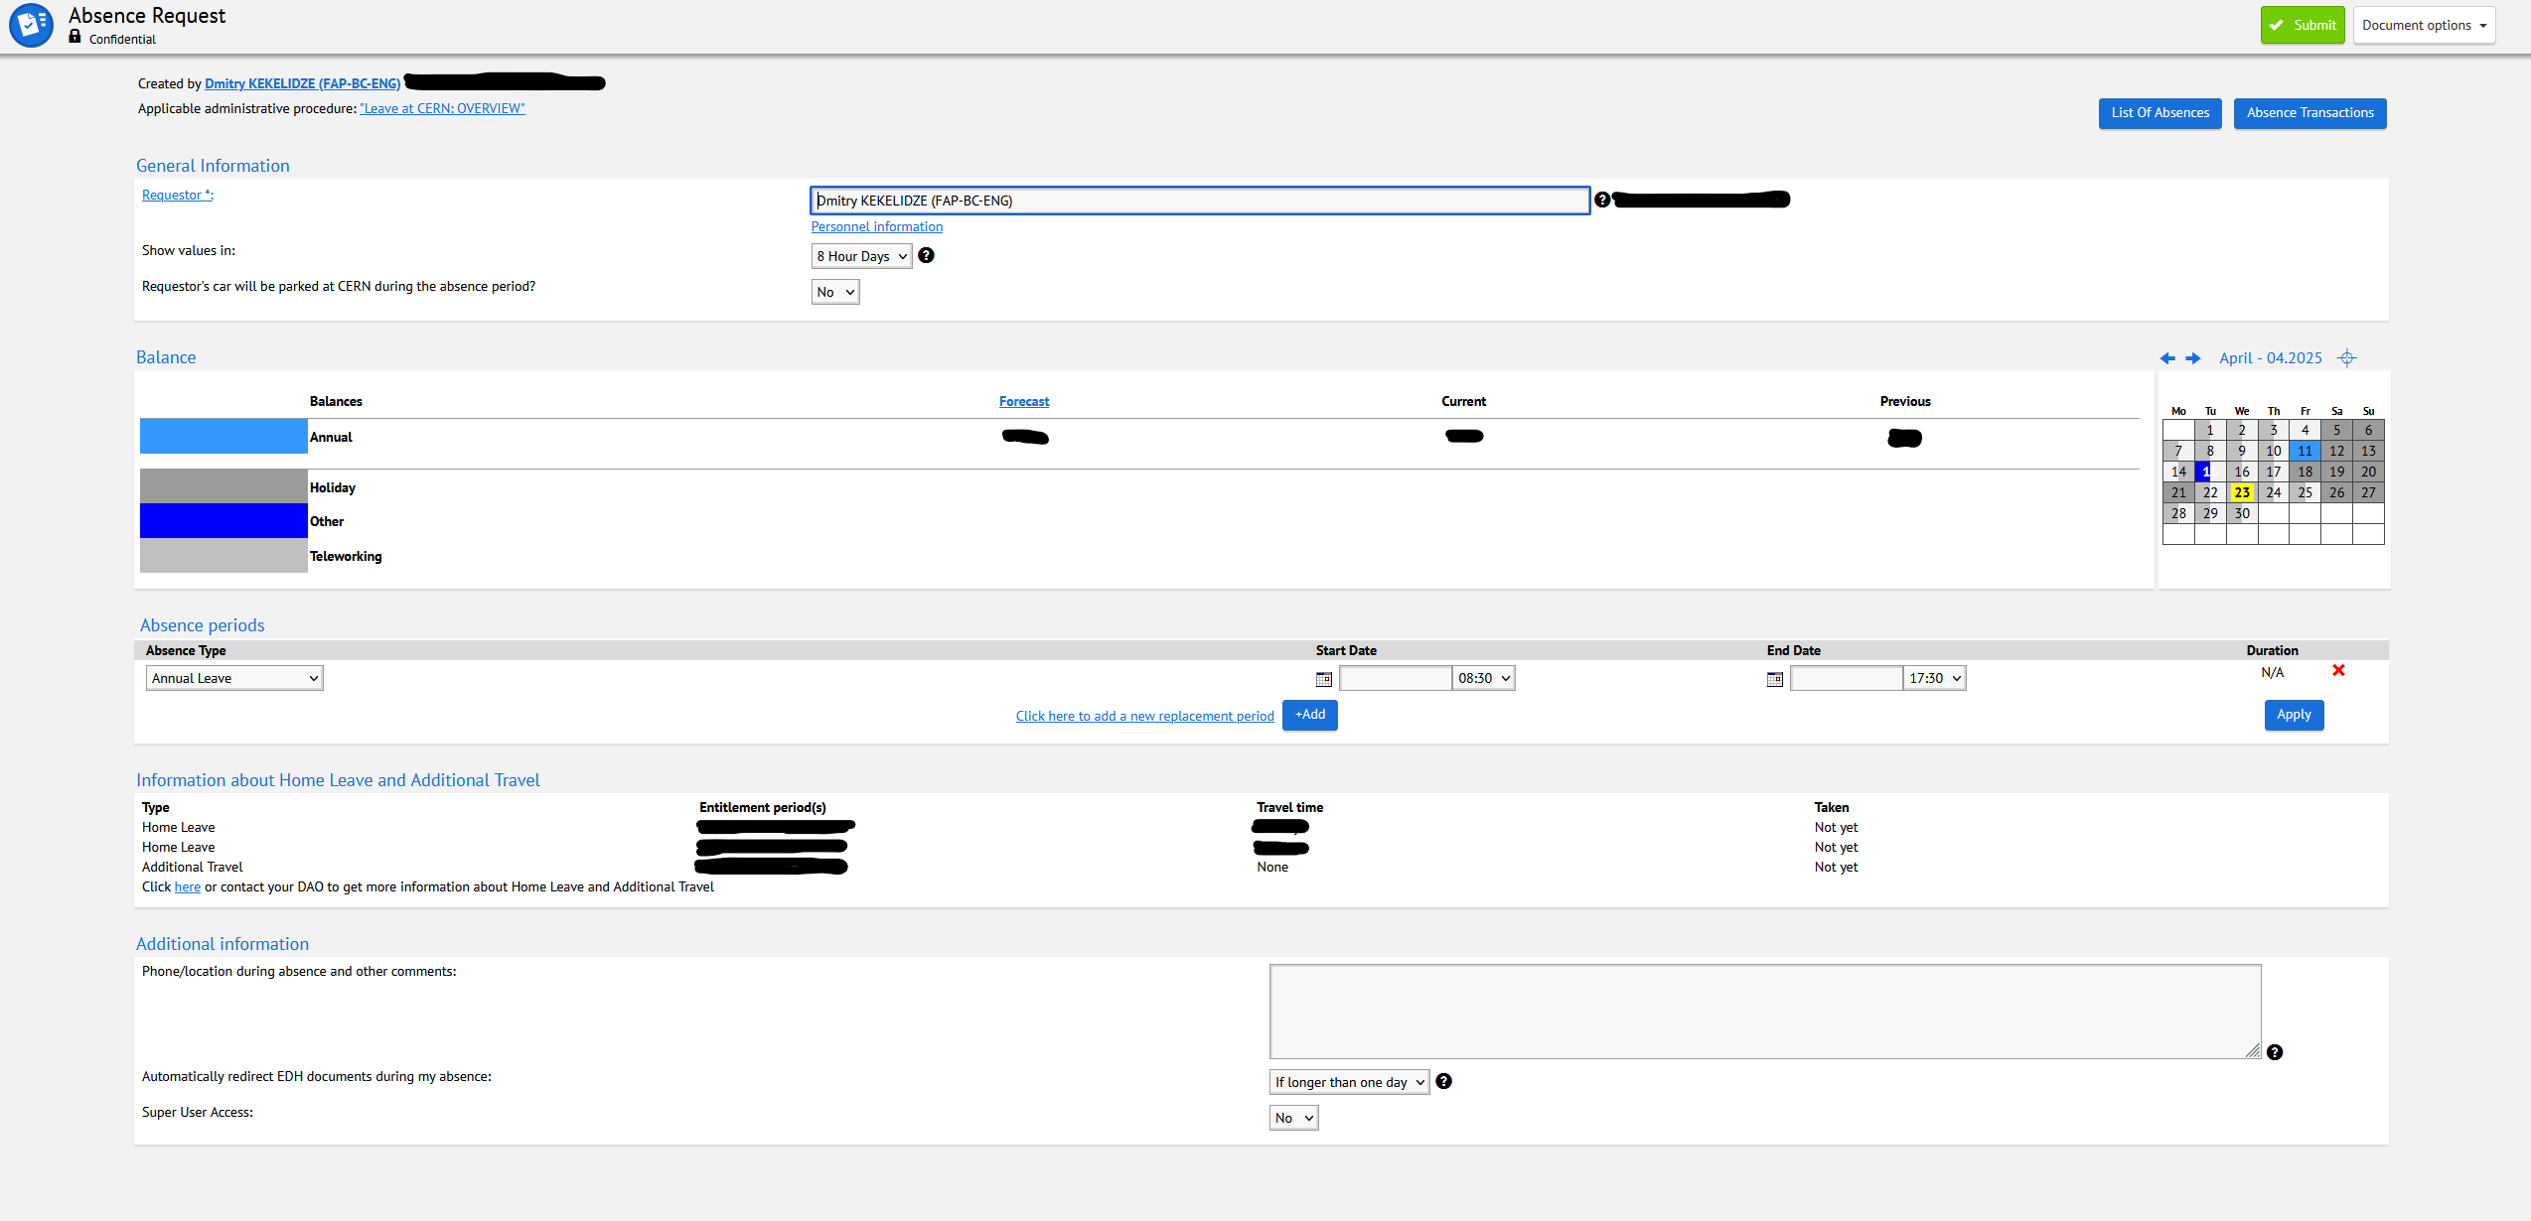
Case study subject

Slide 6

Introduction to React and its Benefits
Notes:
React is a popular JavaScript library used for building user interfaces, especially single-page applications. It allows developers to create dynamic and responsive web applications with ease.

Slide 7

Understanding React
React is a JavaScript library for building rich user interfaces.
It allows developers to create reusable UI components.
It promotes a component-based architecture for better organization.
React can be used for building dynamic single-page applications.
Notes:
React is an open-source JavaScript library developed by Facebook for creating interactive user interfaces. It enables developers to build web applications using reusable components, making development more efficient. React's virtual DOM improves performance by minimizing direct updates to the actual DOM, allowing for smooth user experiences. It's ideal for single-page applications where responsiveness is crucial.

Slide 8

Overview of React
Declarative Nature
React's declarative nature allows developers to describe what the UI should look like, making it easy to manage state changes.
Component-Based Architecture
By using a component-based architecture, React enables the reuse of code, leading to more efficient and organized development.
Simplified UI Development
React simplifies the process of building complex user interfaces by allowing developers to work in smaller, manageable parts.
Notes:
React was developed by Facebook and has gained immense popularity due to its declarative nature and component-based architecture. It simplifies the process of building complex UIs by breaking them down into manageable components.

Slide 9

Overview of JSP
JavaServer Pages (JSP) facilitate dynamic web content creation.
JSP allows embedding Java code directly into HTML for interactivity.
Enables the use of custom tags and libraries for enhanced functionality.
Can be combined with servlets for powerful web applications.
Notes:
JavaServer Pages (JSP) is a technology that simplifies the creation of dynamic web content by allowing Java code to be embedded in HTML. This approach enhances interactivity and supports the integration of JavaBeans, promoting a component-based architecture. Additionally, JSP allows for the use of custom tags and libraries, which enhance application functionality. When combined with servlets, JSP provides a robust framework for developing powerful web applications.

Slide 10

Advantages over static HTML and JSP templates
Simplified Scripting ReactJS uses JavaScript, which is arguably the world’s most popular programming language.
Component Reusability
React allows developers to create reusable components, which reduces redundancy and speeds up development processes.
State Management
React simplifies state management through its built-in hooks, enabling efficient data handling and dynamic UI updates.
Improved User Experience
With React, developers can create highly interactive interfaces, enhancing the user experience significantly compared to static templates.
Faster Development Cycles
The combination of component reusability and effective state management leads to faster development cycles and easier maintenance.
Notes:
React offers significant advantages over static HTML and JSP templates, including reusability of components, ease of state management, and a more interactive user experience. This leads to faster development cycles and improved maintainability.

Slide 11

Core Concepts of React
Notes:
Understanding React's core concepts is crucial for successful development. This section will focus on components, state management, and the lifecycle of components.

Slide 12

Components and JSX
Building Blocks of React
Components serve as the fundamental building blocks for creating dynamic and interactive user interfaces in React applications.
JSX Syntax
JSX allows developers to use HTML-like syntax within JavaScript, enhancing readability and simplifying the creation of components.
Notes:
Components are the building blocks of React applications. JSX allows developers to write HTML-like syntax within JavaScript, making it easier to visualize the UI structure and create components quickly.

Slide 13
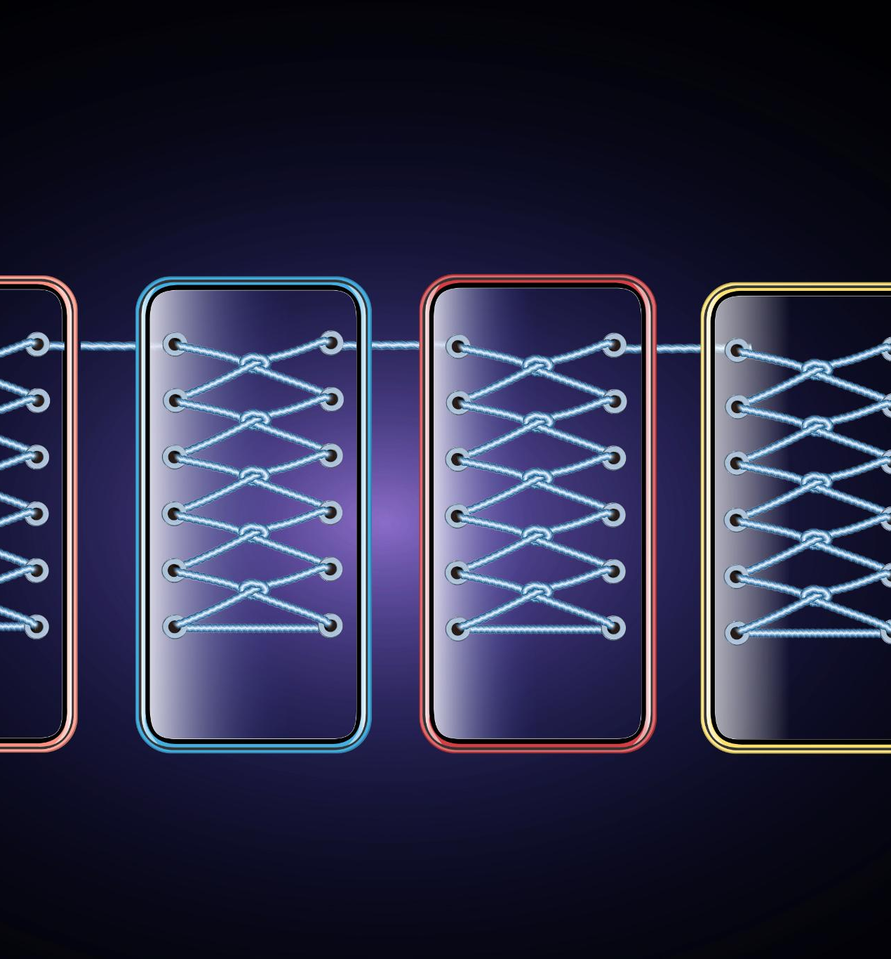
State and Props
Understanding State
State is a built-in object in React that allows components to maintain their own data and update the UI accordingly.
Role of Props
Props are used in React to pass data from parent components to child components, facilitating communication between them.
Notes:
State and props are essential concepts in React. State allows components to manage their own data, while props enable component communication by passing data from parent to child components.

Slide 14
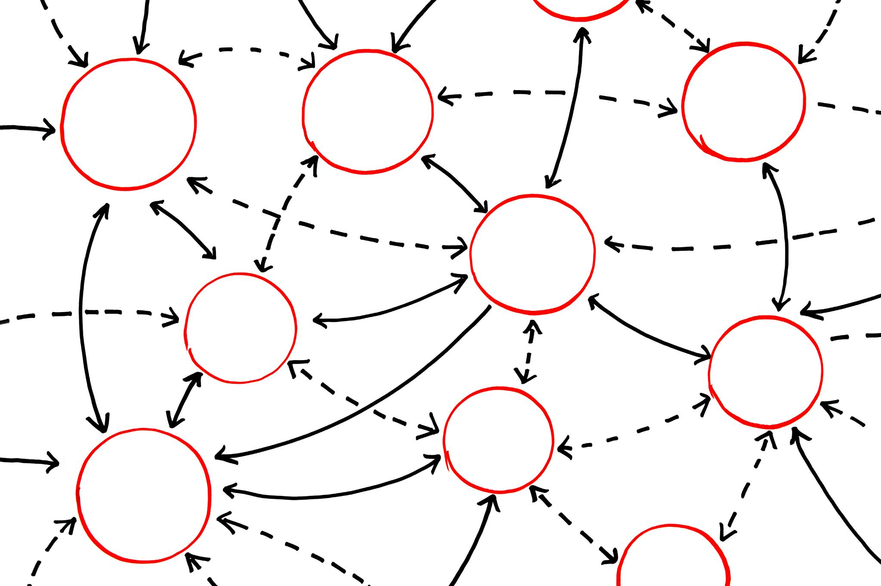
Intoduction to hooks
React Hooks
Hooks offer a simpler and more intuitive approach to managing state and side effects in functional components, improving code readability.
State Management with useState
The useState hook allows developers to add state to functional components, making it easier to manage and update component data.
Side Effects with useEffect
The useEffect hook handles side effects in functional components, allowing developers to manage operations like data fetching and subscriptions.
Notes:
Lifecycle methods are functions that allow developers to hook into different stages of a component's lifecycle. Hooks, such as useState and useEffect, provide a simpler way to manage state and side effects in functional components.

Slide 15

Key Considerations for Migration
Notes:
Migrating from JSP to React requires careful planning. This section will address critical considerations, including assessing the existing application architecture and identifying reusable components.

Slide 16
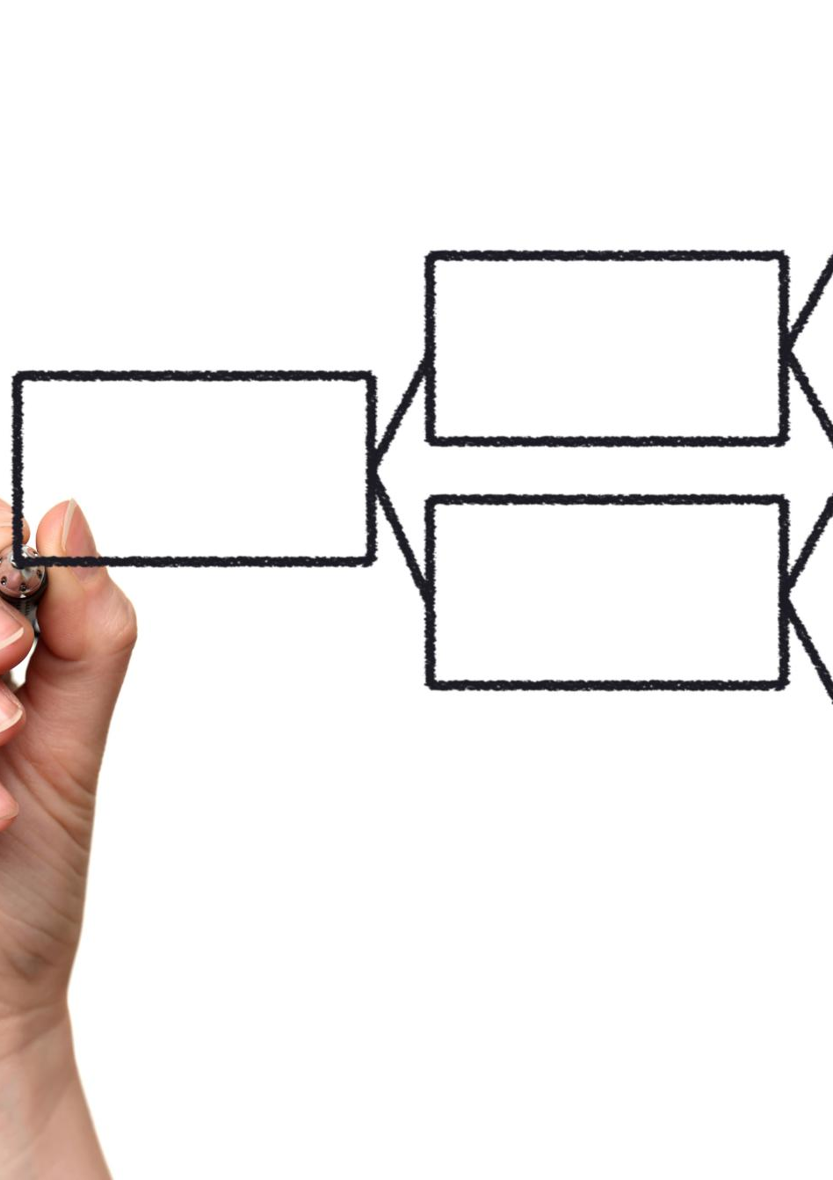
Analyzing the existing monolithic application
Current Application Structure
Understanding the current application's structure is crucial for determining its components and layout before migration.
Functionality Overview
Assessing the functionality of the current application helps in identifying essential features to retain in the new React version.
Dependency Analysis
Analysing dependencies within the legacy application is vital for any successful migration, ensuring compatibility and performance.
Notes:
Begin by analysing the current JSP application to understand its structure, functionality, and dependencies. This will help identify which parts of the application can be migrated to React.

Slide 17
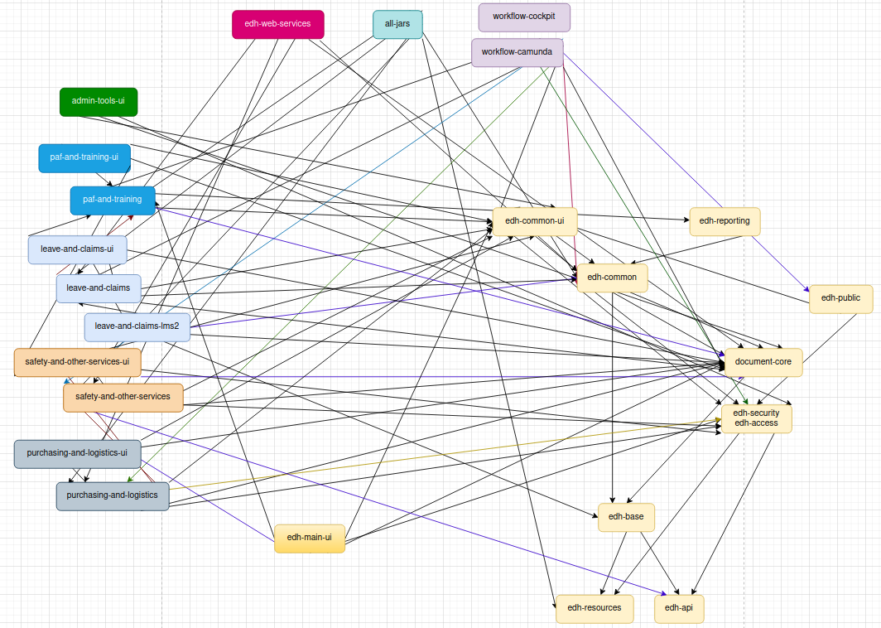
Application codebase
The size of the Java classes alone is ~150 MB, which is approximately the entire Harry Potter series in digital format or around the size of the code needed for controlling a rocket launcher, including all the necessary algorithms and safety protocols.
It features a sophisticated multi-module architecture with interdependencies.
There are various entry points, including UI, API, and scripts, along with integrations with third-party systems.
The project includes undocumented features, intricate business logic, and a deficiency in automated testing.

Slide 18

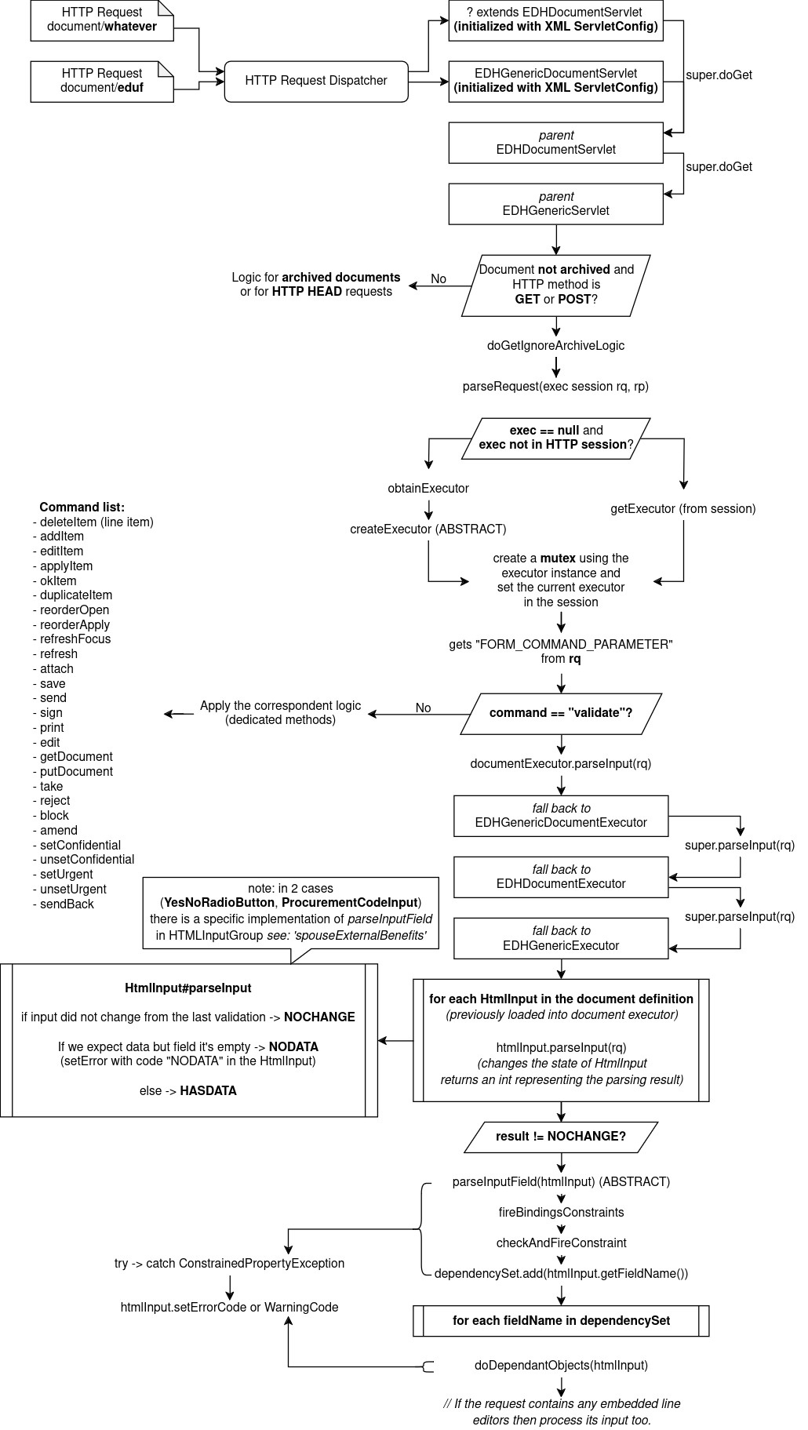
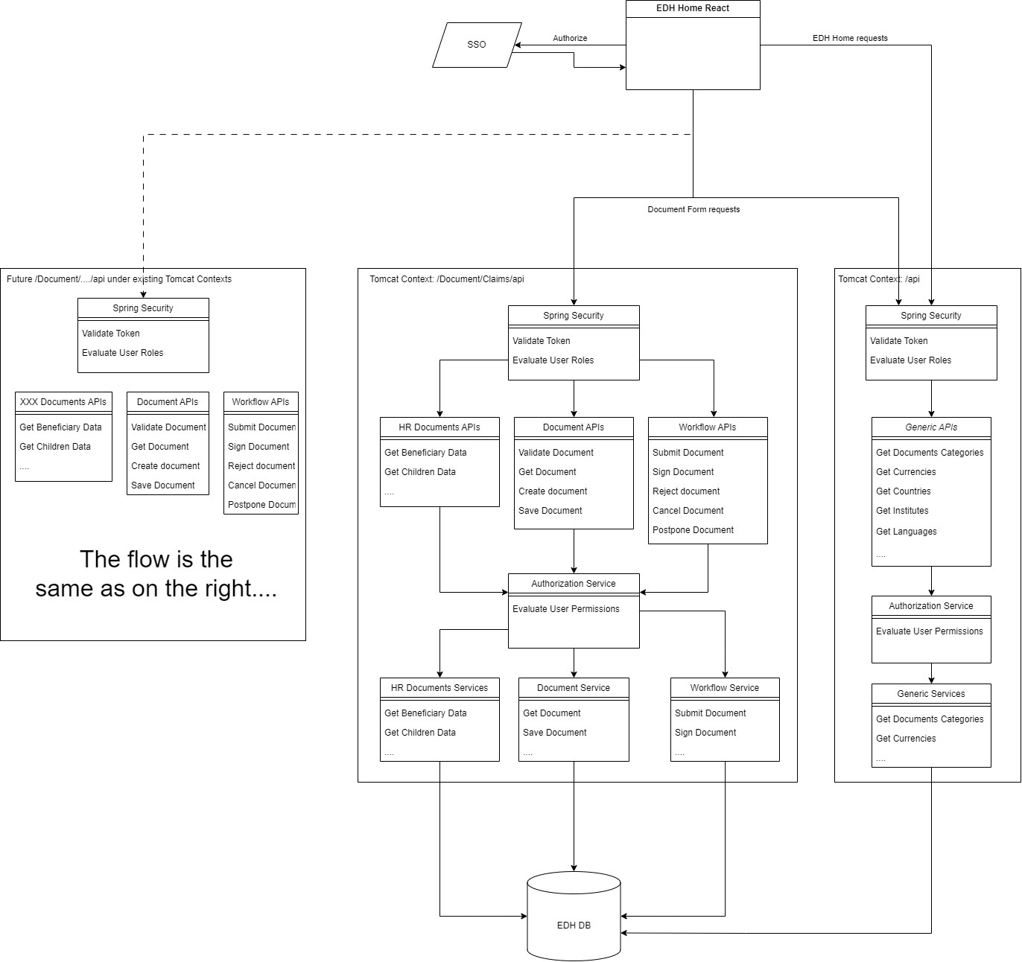

Slide 19

Identifying reusable components
Component Identification
Identifying reusable components in the current application UI can streamline the development process for its React implementation.
Time Saving Benefits
Reusing components saves development time and resources, allowing for quicker project completion.
Consistent User Interface
Using reusable components enhances the consistency of the user interface across applications, leading to a better user experience.
Notes:
Identify components within the JSP application that can be reused in the React application. This not only saves time but also enhances the consistency of the user interface.

Slide 20
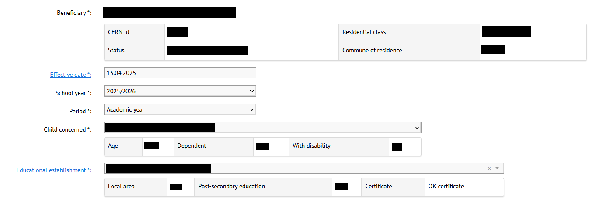
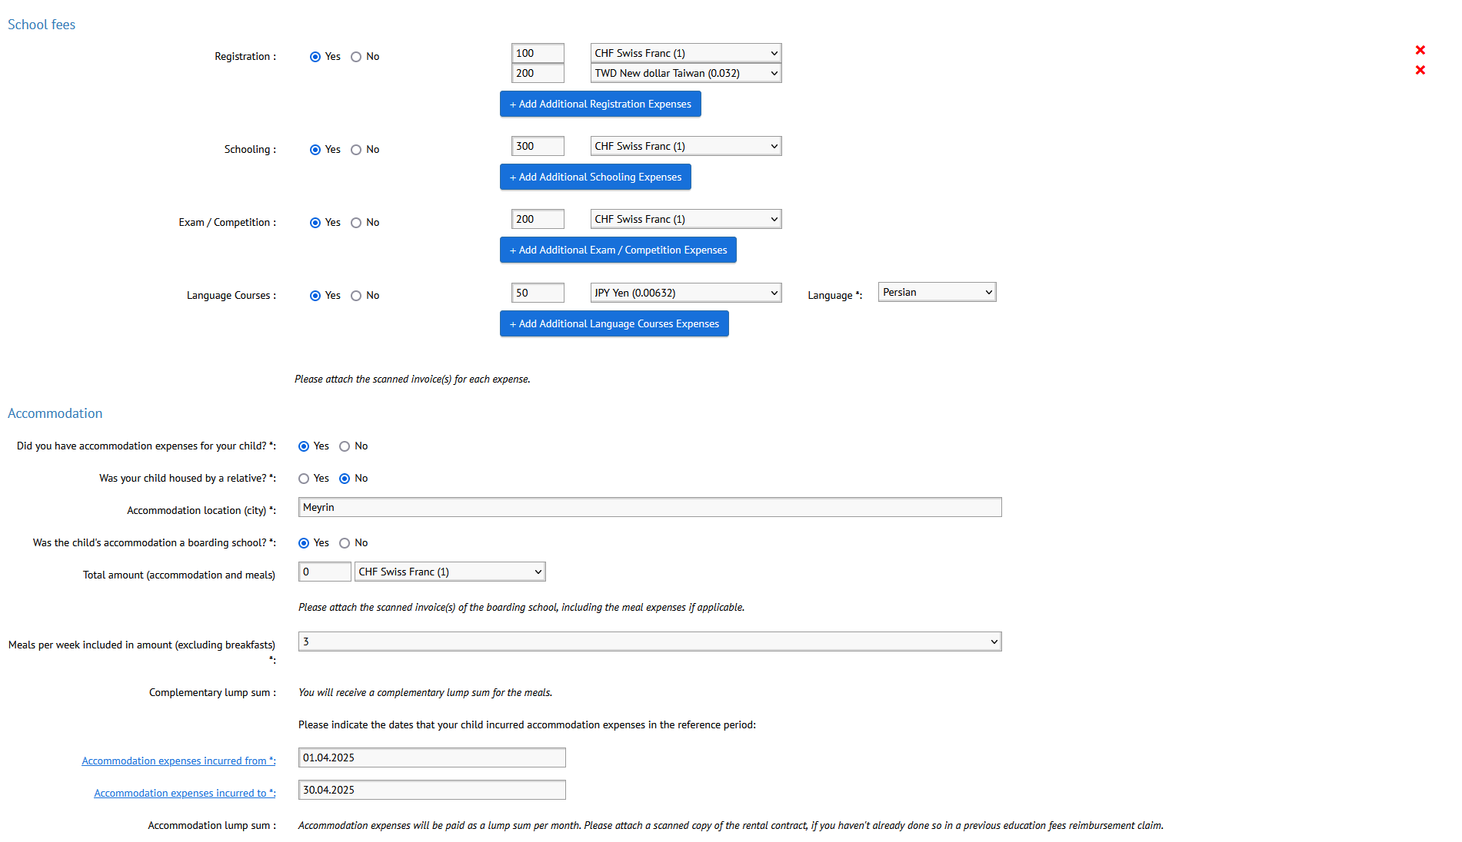
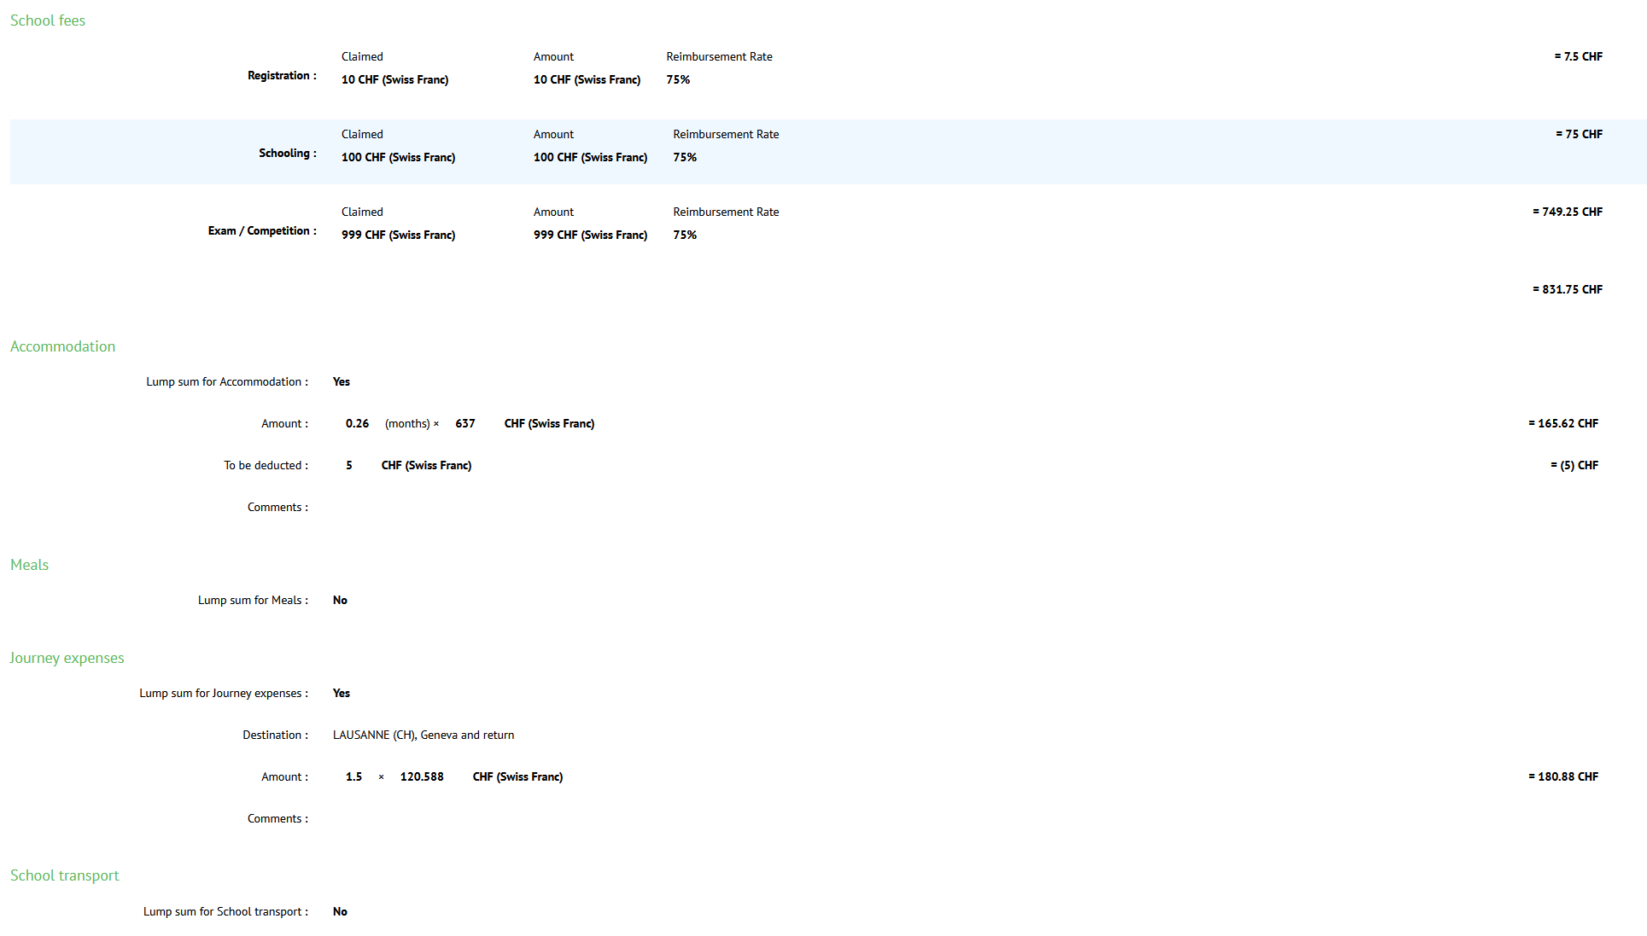

Slide 21
Reusable components to accelerate the migration
Develop MUI based components
Determine the document with the most complex form
Migrate the current document form as it is
Identify reusable form components for other documents
Generalize those components from the migrated form
Share through Storybook
Autocomplete selector
Date picker
Radio group
Field array (multiline)
Simple text input
…

Slide 22

Understanding MUI Components
MUI components are pre-built UI components for React applications.
They follow Material Design principles for a consistent look.
MUI components enhance development speed and efficiency.
Notes:
MUI components are designed for React applications, adhering to Material Design principles. This ensures a cohesive and attractive user interface. By utilizing these pre-built components, developers can significantly speed up the development process and enhance efficiency in creating responsive and modern web applications.

Slide 23

Understanding Material Design Principles
Material Design is a design language developed by Google.
It focuses on creating a cohesive and intuitive UI experience.
Encourages responsive animations and transitions for interactivity.
Promotes accessibility and user-friendly design standards.
Notes:
Material Design principles aim to create a unified experience across different devices and platforms. This design philosophy emphasizes using shadows and depth to guide users' attention, improving the interface's organization and usability. Additionally, responsive animations enhance the overall user experience, making interactions feel fluid and natural. Accessibility is also a key focus, ensuring that designs cater to diverse users.

Slide 24

Benefits of Using MUI Components
Increases productivity with ready-to-use components.
Promotes design consistency across applications.
Customizable themes enhance brand identity.
Notes:
Using MUI components boosts productivity as developers can leverage ready-to-use pieces of functionality, ensuring design consistency throughout the application. Additionally, MUI offers customizable themes, allowing businesses to maintain their brand identity while using these components, creating a seamless user experience.

Slide 25
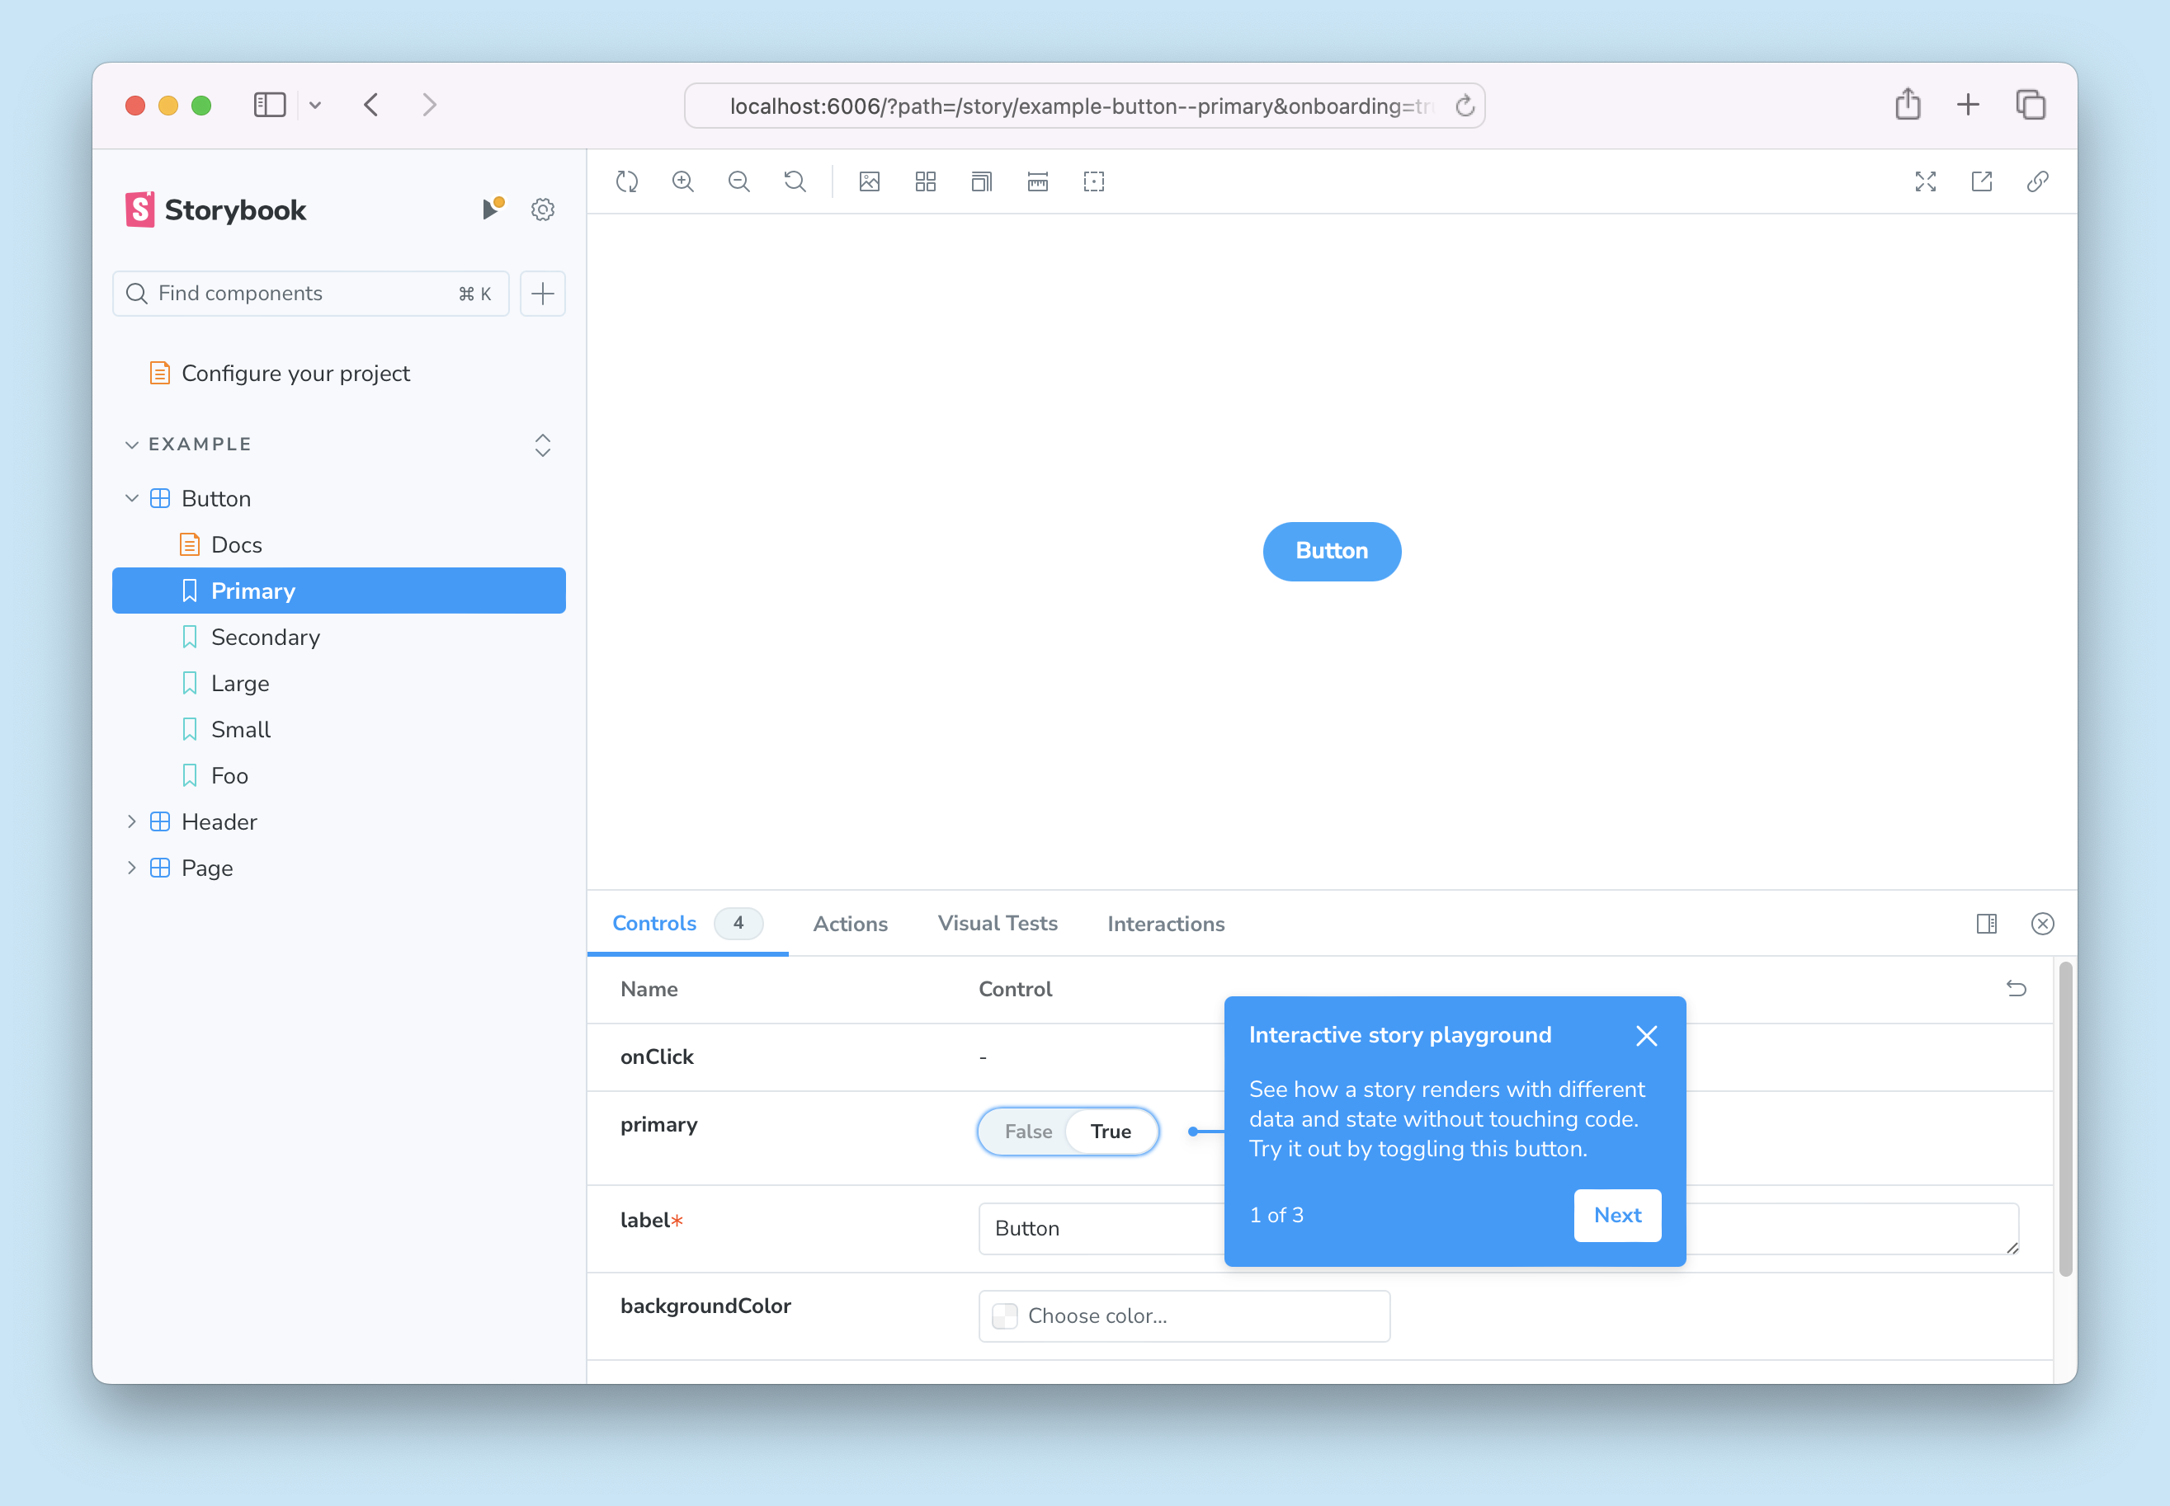
Storybook
Centralized Repository: All core components are stored in one location for easy access by developers across teams.
Reusability: Storybook enables modular components, minimizing redundancy and accelerating development.
Design Consistency: A unified component library ensures a consistent appearance across all documents, improving user experience.
Collaborative Environment: Storybook offers a space for developers to experiment with and configure components, promoting innovation and teamwork.
Improved Documentation: Each component comes with detailed documentation and examples, aiding developers in understanding and using them.

Slide 26
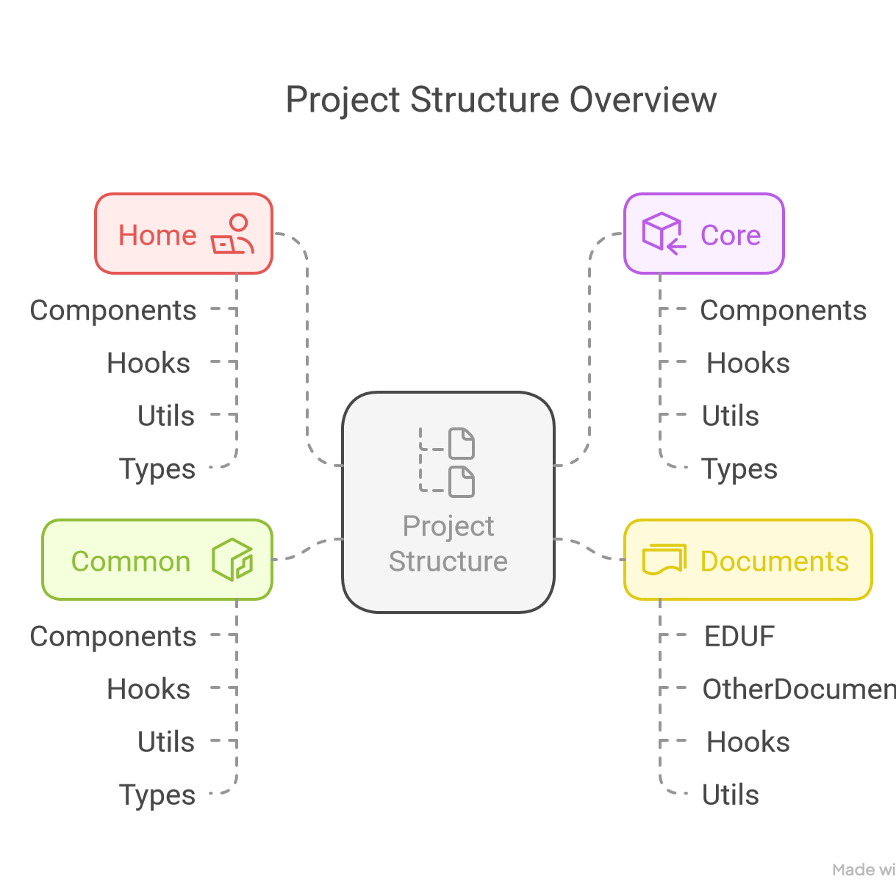

Slide 27

Migration Path from JSP to React
Notes:
The migration process from JSP to React can be approached incrementally. In this section, we will outline the steps necessary for a successful migration.

Slide 28

Gradual replacement of JSP pages with React components
Incremental Replacement
A gradual approach to replacing existing front-end pages enables a smoother transition to React SPA front-end, minimizing disruptions.
Testing and Validation
This method allows for early user testing testing and validation of React UI, ensuring functionality before full CERN-wide release.
Minimizing Disruptions
By adopting this approach, developers can avoid major disruptions to the application, maintaining user experience.
Notes:
Adopt a gradual approach by replacing JSP pages with React components incrementally. This allows for testing and validation without disrupting the entire application at once.

Slide 29

Handling Legacy Code and Ensuring Compatibility
Careful Migration Process
Effective migration requires careful handling of legacy code to avoid disruptions in functionality.
Ensuring System Compatibility
Compatibility between old and new systems is crucial for seamless integration and user experience.
Service Layers and APIs
Creating service layers or APIs facilitates data access and interoperability between systems.
Notes:
During migration, it's essential to handle any legacy code with care and ensure compatibility between the old and new systems. This may include creating service layers or APIs for data access.

Slide 30

Code Examples and Practical Implementation
Notes:
This section will cover practical examples of converting JSP code to React, showcasing how to manage user input and integrate with existing backend services.

Slide 31

Managing forms and user input in React
Implementing Forms
We will discuss effective ways to implement forms in React applications, ensuring smooth user interactions.
Handling User Input
Learn how to handle user input effectively in React, making sure the application's state is updated accordingly.
Notes:
Managing user input in React can be done using controlled components. We will cover how to implement forms in React and handle user input effectively.

Slide 32

Integrating React with existing backend services
Making API Calls
Understanding how to make API calls is essential for data retrieval in a React application, ensuring data is fetched efficiently.
Handling Data Retrieval
Effectively handling data retrieval is crucial for managing the state in React applications and providing real-time updates to users.
Notes:
To ensure that the React application works seamlessly with existing backend services, we will discuss how to make API calls and handle data retrieval.

Slide 33

Final Benefits of Migration
Notes:
Migrating to React offers numerous advantages that contribute to the long-term success of the application. This section will summarise the key benefits.

Slide 34

Improved Development Workflow and Faster Iterations
Component-Based Structure
React's component-based structure facilitates the development of scalable applications by organizing code into manageable and reusable parts.
Efficient Workflow
React allows teams to streamline their development processes, reducing redundant tasks and increasing productivity.
Quicker Iterations
With React's component-based architecture, teams can implement changes more rapidly, leading to quicker iterations on projects.
Faster Time-to-Release
Adopting React enables faster deployment of new features, enhancing the speed at which products reach the market.
Notes:
With React, development teams can benefit from a more efficient workflow, enabling quicker iterations and faster time-to-market for new features and updates.

Slide 35

Future-proofing the application with modern technologies
Scalability Benefits
As applications grow, React's architecture supports scalability, enabling teams to better manage complex features.
Easier Updates
With React, developers can update individual components, allowing for efficient changes without disrupting the entire application.
Relevance of Modern Technologies
Adopting modern technologies ensures that the application stays relevant in an ever-evolving tech landscape.
Adaptability to Changes
Using contemporary frameworks allows for quick adaptation to changes in user needs and technology trends.
Notes:
Migrating to React not only enhances the current application but also positions it for the future. Adopting modern technologies ensures that the application remains relevant and adaptable to changes in the tech landscape.

Slide 36
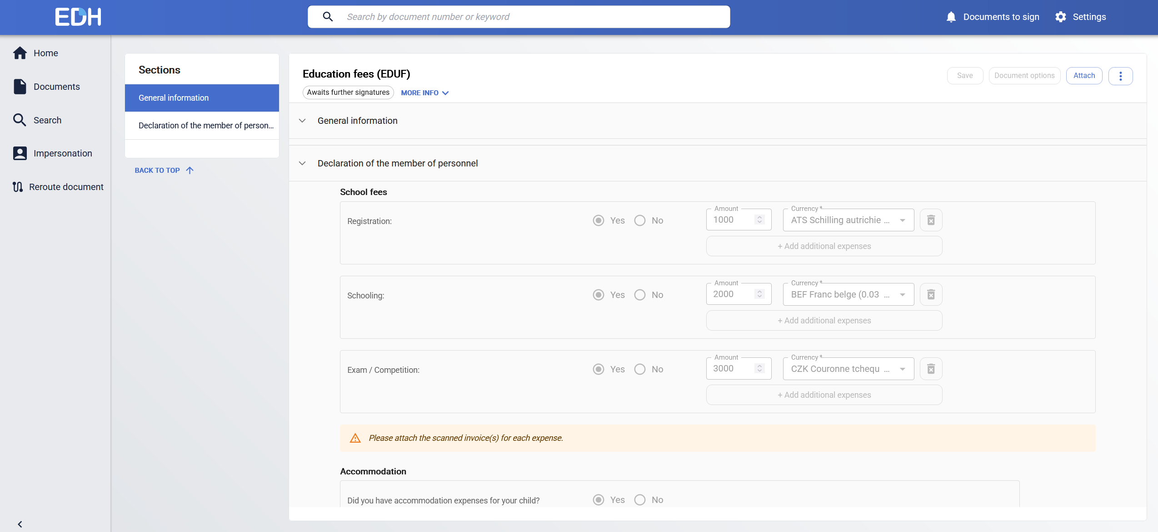
Case study subject (updated)

Slide 37
Conclusion
Improved User Experience
Migrating to a modern React application enhances the user interface, making it more intuitive and engaging for users.
Faster Development Speed
React's component-based architecture allows for quicker development cycles, enabling teams to deliver features faster.
Enhanced Maintainability
Transitioning to React improves code maintainability, making it easier to manage and update the application over time.
Staying Competitive
Adopting modern technologies like React is crucial for businesses to remain competitive in a rapidly evolving digital landscape.
Notes:
In conclusion, migrating from a legacy JSP front-end to a modern single-page React application can significantly improve user experience, development speed, and application maintainability. This transition is essential for staying competitive in today's fast-paced digital environment.

